Slide 1
FIRST LEVEL CHECKING
(FLC)
OF EVM & VVPAT
Administrative arrangements

Slide 2
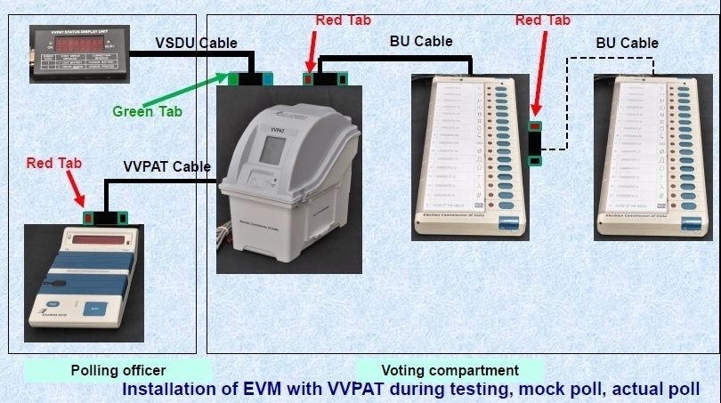
TYPES OF MACHINES
2

Slide 3
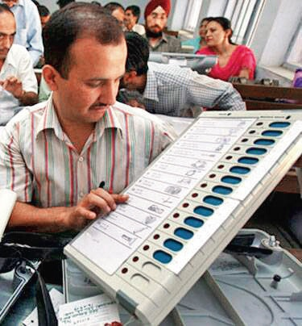
FIRST LEVEL CHECKING OF EVM
Technical, physical & functional examination of the machines by the engineers of BEL or ECIL
1
2
FLC is done sufficiently in advance to ensure it is carried out thoroughly.
3
FLC should be started 180 / 120 /within 30 days, in case of Lok Sabha/ LA / Bye Election
3

Slide 4
Responsibilities of CEO
Help the Commission prepare a timely FLC Schedule & Coordinate timely Start/completion of FLC
1
2
Procurement of required number of Pink Paper Seals and other consumables required for FLC..
3
Depute Officials from CEO’s office to ensure proper FLC training, visits during actual FLC conduct and regular monitoring of FLC.
4

Slide 5
Responsibilities of DEO
DEO Overall In-charge and responsible for the conduct of FLC in the district.
1
2
Responsible for making all necessary arrangements for FLC and ensuring smooth conduct of FLC.
5

Slide 6
FLC to be done in Presence of Representatives POLITICAL PARTIES
Communicate FLC Schedule to all Political Parties
Maintain a Log book of all visitors to the FLC hall
FLC Supervisor must be a ADM rank Officer only.
6

Slide 7
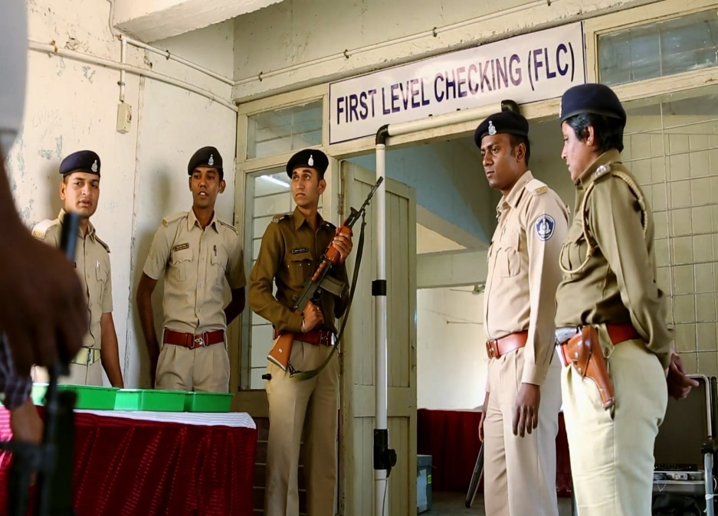
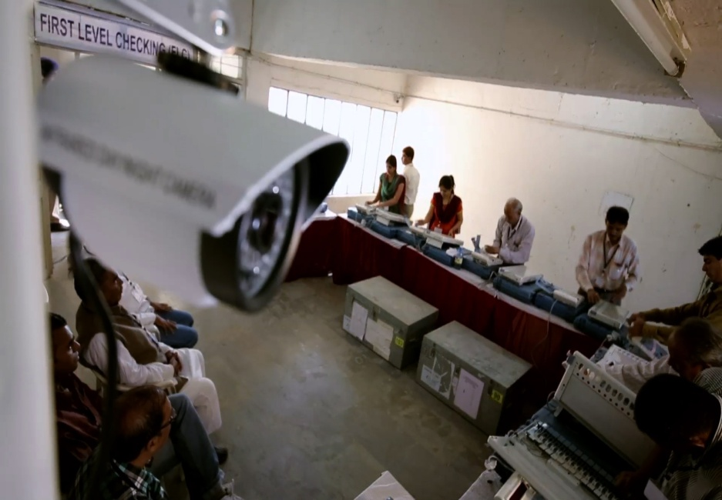
ARRANGEMENTS FOR FLC
Large sanitized hall- free of other electronic devices and components; only 2 mob allowed for marking FLC Ok
FLC in-charge of district; engineers of BEL or ECIL and representatives of political parties to be present
Spacious hall to provide adequate working and storage space for EVMs
Entry guarded by Police and record of all visitors to be maintained
Video recording/Web casting/CCTV of entire FLC process for monitoring by DEO/CEO/Commission, and reporting to ECI
DEO to issue certificate for the arrangements
7

Slide 8
SUPPORT REQUIRED FOR FLC
Provision of 230 V Electrical points near each table.
Adequate lighting in FLC hall
Sufficient labour for assisting the engineers in shifting, cleaning etc
Provision of pink paper Seals and staff for maintaining the FLC records
Provision of sufficient tables and chairs to work on 25 + 25 EVMs
Set of CU/BU/VVPAT
8

Slide 9
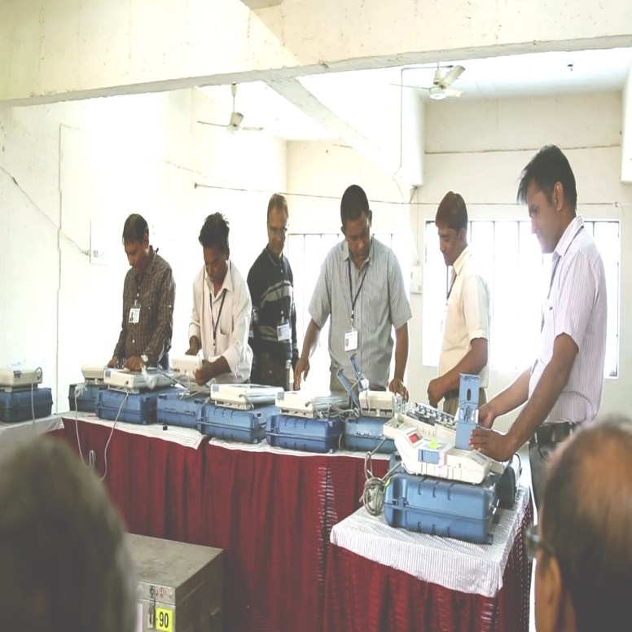
MANPOWER
FLC shall be carried out only by engineers of BEL or ECIL.
List of engineers deputed by BEL or ECIL for FLC in a district, along with their identity details shall be communicated in writing to the DEOs.Randomization of deployed engineers will be done by CEO.
Each team will have around 5 members with one as Team Leader
BEL / ECIL District Managers for overall coordination & technical assistance to the FLC teams ; 1 for every 4-5 districts.
A Senior manager at state level for overall supervision and coordination
District managers will visit allotted districts along with ECI observers, before start of FLC
9

Slide 10
WORK TO BE DONE IN FLC-1
Confirmation tests for integrity & efficacy of CU, BU,VVPAT working
Physical inspection for broken doors, flaps, latches, carry cases
Functional check of all switches,
connectors, cables etc
Cleaning & Removal of seals, tags, Ballot Papers, previous poll data, symbols
Responses of all switches
Full functionality checks
Visual Inspection of EVMs
Preliminary steps
10

Slide 11
FLC OF EVMs & VVPATs
Responsibility of CEO for Donor State
Work to be done during FLC (Contd..)
Full functionality Test test
.
Opening of cabinet of EVM and showing to political party representatives
Confirming that all components are original
Checking of all switches in CU & BU, doors (flaps), sealing provisions etc.

Slide 12
WORK TO BE DONE IN FLC-2
VVPATs will be loaded with neutral symbols for T&A activities
Engineers to certify all components of the EVMs are functioning
Engineers to check and certify that all components are original
Show opened CU to political party representatives
12

Slide 13
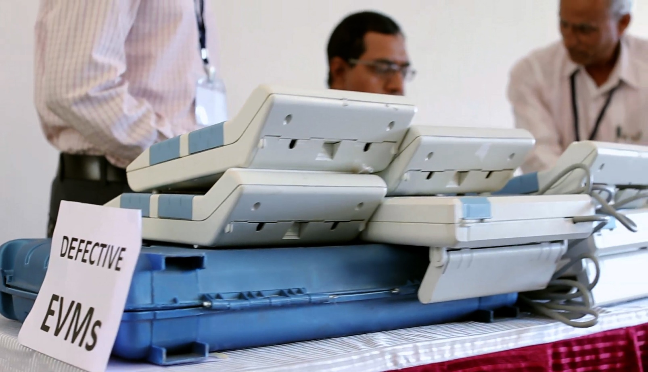
WORK TO BE DONE IN FLC-3
Defective EVMs shall be stored in the “Defective EVMs” warehouse and sent to factory for repairs within 7 days of FLC completion.
SoP for FLC to be prominently displayed in the FLC hall.
Job being performed at each work-station may also be displayed
13

Slide 14
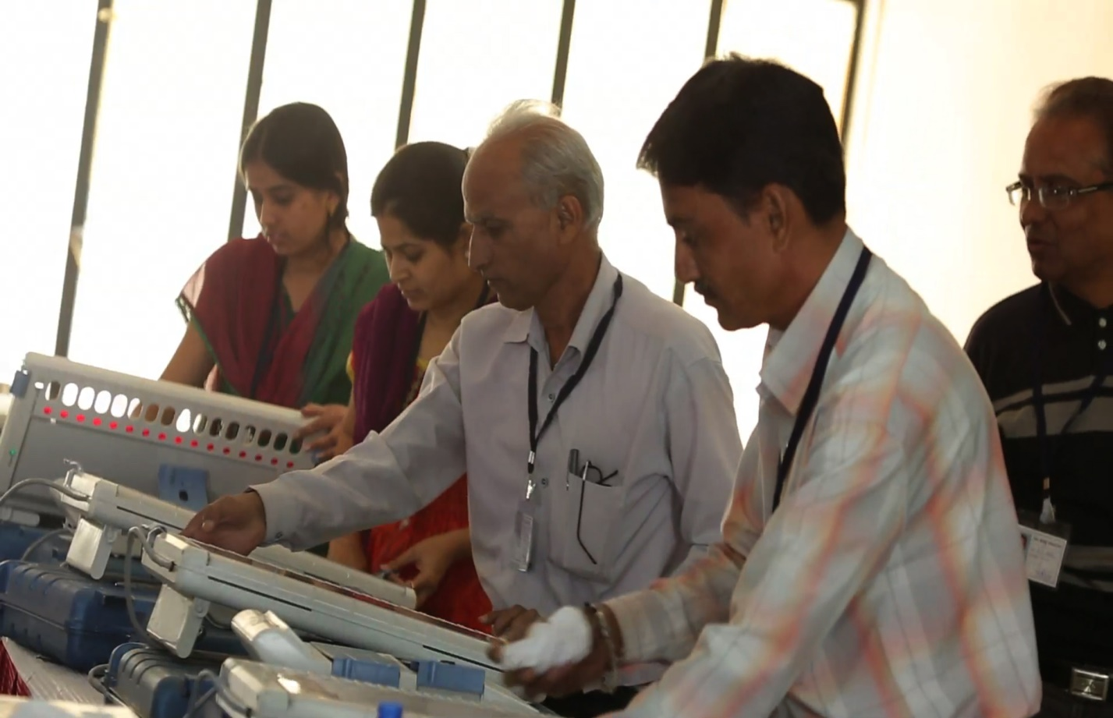
WORK TO BE DONE IN FLC-3
Casting of one vote against all 16 candidate switches (total 16 votes), observation of result & clearing of mock poll data will be done for each CU-BU
In case of VVPATs, mock poll with 6 votes for each of the 16 candidate buttons (total 96 votes), observation of result and tallying electronic count with paper slip count shall be done for each VVPAT
Use Mob App 2 (Shifting/FLC/Randomization App) for marking FLC ok EVMs in ETS and for storing Pink seal ID (numerals only)
14

Slide 15
MOCK POLL DURING FLC
Mock Poll—FLC OK EVMs to be randomly selected by political party representatives and Mock poll conducted as :
In 1% EVMs 1200 votes
In 2% EVMs 1000 votes
In 2% EVMs 500 votes
Results of Mock poll will be tallied with manual record and printed slip count of VVPAT
15

Slide 16
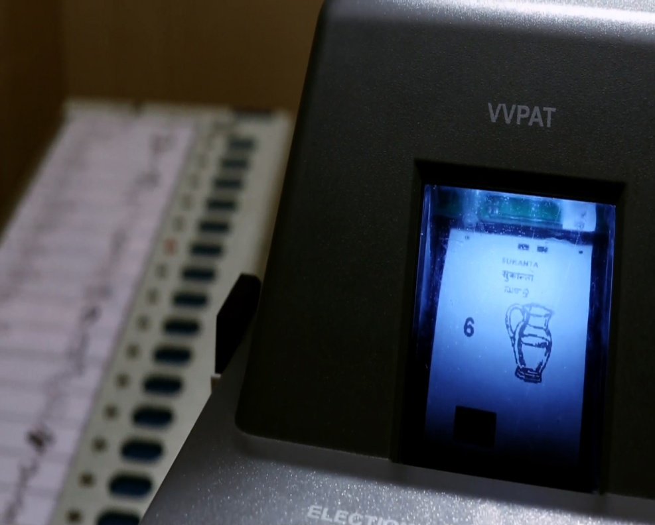
VERIFICATION OF MOCK POLL RESULT
Signatures of representatives of political parties shall be taken confirming that there are no discrepancies between the CU count of votes polled during the mock poll and VVPAT slip count.
16

Slide 17
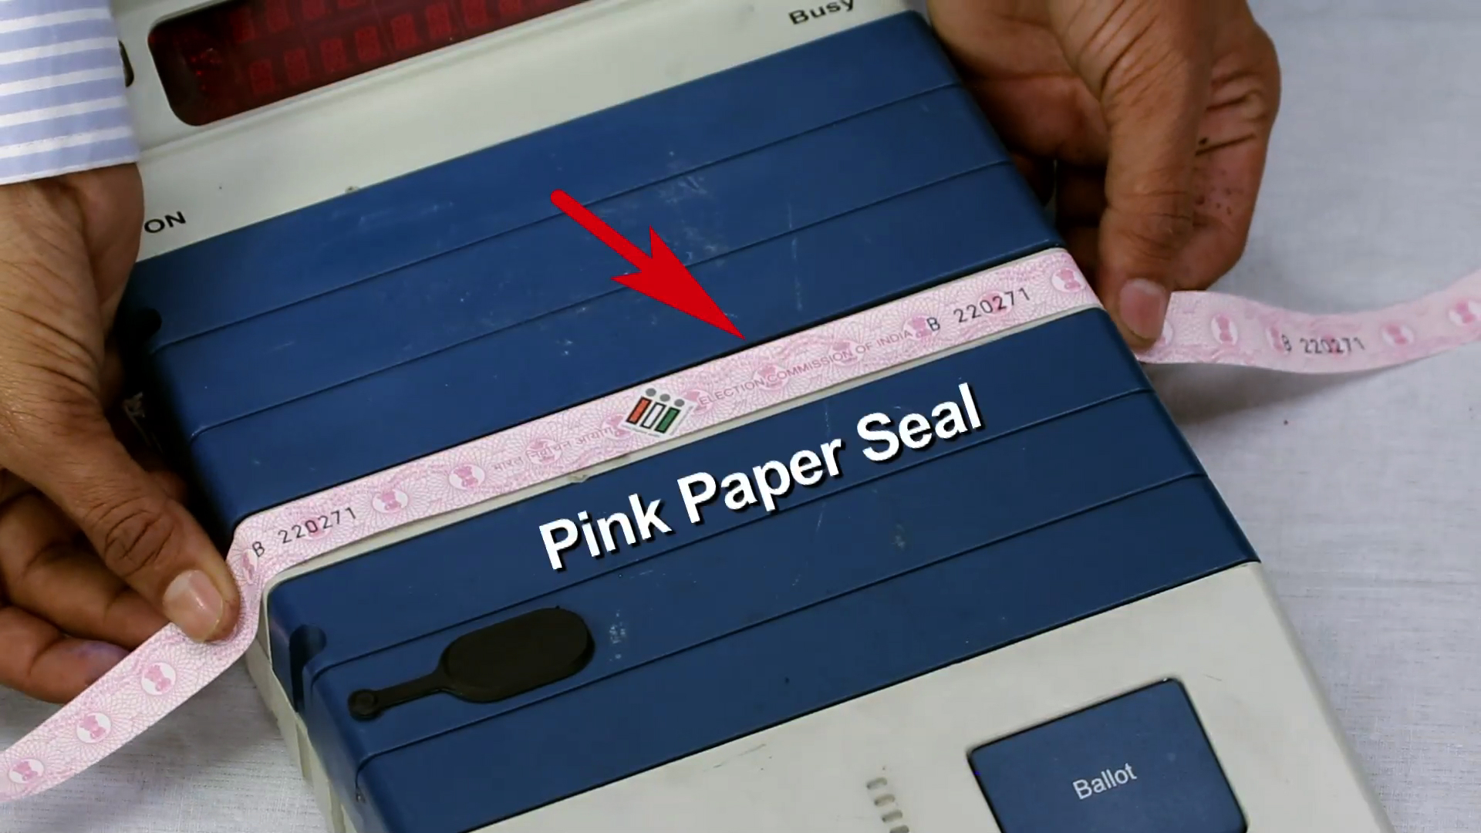
SEALING OF CU
To block access to internal components after FLC, the Control Units shall be sealed with the ‘Pink Paper Seal’ in the presence of representatives of Political Parties
The BEL/ECIL Engineer, DEO’s officer and political party representatives shall sign on the Pink Paper Seal.
S.No of Seal & CU to be recorded and copy given to representatives of Political parties
17

Slide 18
FLC OF EVMs & VVPATs
Responsibility of CEO for Donor State
Supervision of FLC
An officer not below rank of ADM to personally supervise the FLC.
FLC-OK and FLC-rejected EVMs & VVPATs shall be marked in ETS using Mobile App (Shifting/FLC/Randomization App) on same day before the close of work.
CCTV coverage of FLC for monitoring at DEO/CEO/ECI level
CCTV Coverage of FLC for monitoring at DEO/CEO level.
Web Casting /Video-recording of FLC proceedings.
All FLC-rejected units to be despatched to PSUs for repairs within 7 DAYS of completion of FLC.

Slide 19
RESPONSIBILITIES OF FLC INCHARGE
Close Monitoring to ensure no shortcuts are adopted by Engineers in the FLC Process
Availability of casual labour to expedite FLC work
Presence of Political Party representatives during FLC
Providing new power packs and paper rolls for FLC
Availability of tables, chairs, power points, drinking water etc
Signing Green ‘FLC ok’ Sticker only after his satisfaction
Transfer of FLC Ok and FLC defective EVMs to respective warehouses in ETS-Use Mob app 2 (Shifting/FLC/Randomization App) for this
Storage and sealing of FLC passed EVMs in FLC strong room in presence of political party representatives.
19
Notes:
Close monitoring to ensure no shortcuts are adopted by Engineers in the FLC process
Availability of casual labour to expedite FLC work
Presence of political party representatives during FLC
Providing new power packs and paper rolls for FLC
Availability of tables, chairs power points, drinking water etc
Transfer of FLC Ok and FLC Defective EVMs in respective warehouses in ETS– Use Mob app 2 for this

Slide 20
RESPONSIBILITIES OF DEOs
Selection of appropriate place for the FLC and nominating FLC in-charge (Dy DEO or above)
1
2
Provisioning for logistics support
3
Sensitisation of political parties to maximise their participation in the FLC process
3
Finalisation of the FLC schedule so as to ensure adequate time availability
4
Ensuring proper preparation for conduct of FLC during the ECI observers visit, prior to start of FLC
5
20

Slide 21
RESPONSIBILITIS OF DEOs
Monitoring the rejections, quality and progress of FLC through frequent visits to FLC hall
6
7
Arrangement of additional warehouse for VVPATs.
3
Provisioning for new power packs and paper rolls for use during FLC
8
9
All movements of EVMs to be only through ETS
No EVM to be used for T&A activities without undergoing FLC
10
Storage of FLC passed EVMs in FLC strong room in presence of political party representatives
11
21

Slide 22
RESPONSIBILITIES OF DEOs
After completion of FLC of CU/BU/VVPAT and marking in ETS, DEO to submit Certificate to CEO
12
CEO to submit similar Certificate (Consolidated) to ECI
13
3
Deployment of min One section of Armed Police for 24x7 security of strong with FLC Ok EVMs
14
Availability of Fire alarm and adequate number of fire extinguishers
15
16
For details refer circular dated 30th Aug 2017
Thank You
22

